Slide 1
Collaborative Inference via Ensembles on the Edge
N. Shlezinger, E. Farhan, H. Morgenstern and Y. C. Eldar, "Collaborative Inference via Ensembles on the Edge," ICASSP 2021 - 2021 IEEE International Conference on Acoustics, Speech and Signal Processing (ICASSP), 2021, pp. 8478-8482
Professor: Dr. Chih-Yu Wang
Presenter: Shao-Heng Chen
Date: February 9, 2022

Slide 2
Task-offloading vs. Edge ensemble
1. Co-inference ≠ C0llaborative inference?
2. Sequential manner / Parallel nature
3. Centralized / Decentralized
4. Constant connectivity required / Limited connectivity
5. Requires all users participation / Allows arbitrary number of users
1

Slide 3
Deep Ensembles
1. Combine multiple models’ outputs to achieve improved results.
2. Aggregation techniques depending on the overall task: averaging for
soft outputs, majority voting for hard-decision classifier.[1]
3. Require models to be diverse while designed for the same task.
[1] O. Sagi and L. Rokach, "Ensemble learning: A survey", Wiley Interdisciplinary Reviews: Data Mining and Knowledge Discovery, vol. 8, no. 4, 2018.
2

Slide 4
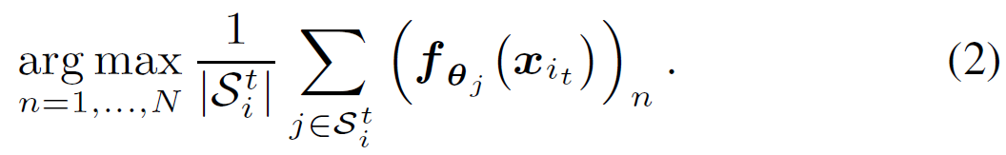
Edge Ensemble Inference Protocol
Provide each user the ability to carry out inference on its own, while allowing to benefit from collaboration with neighboring devices through ensemble mechanism.
3

Slide 5
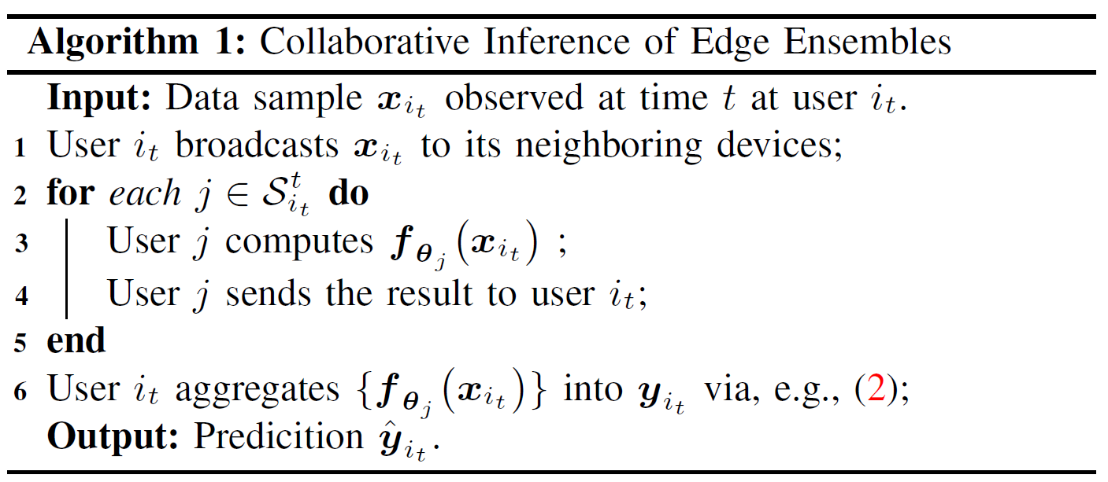
Algorithm 1.
4

Slide 6
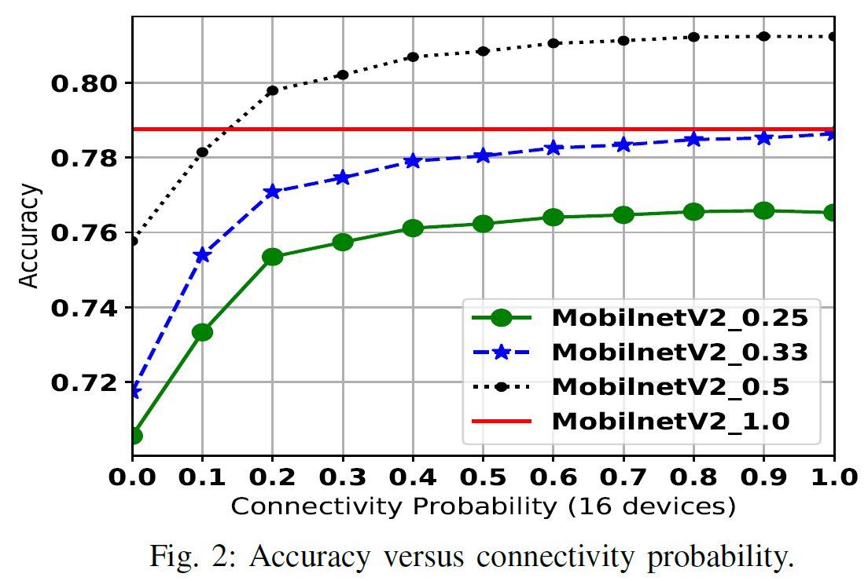
Accuracy vs. connectivity probability
width factor 0.5
→ 30% parameters
width factor 0.25
→ 6% parameters
5

Slide 7
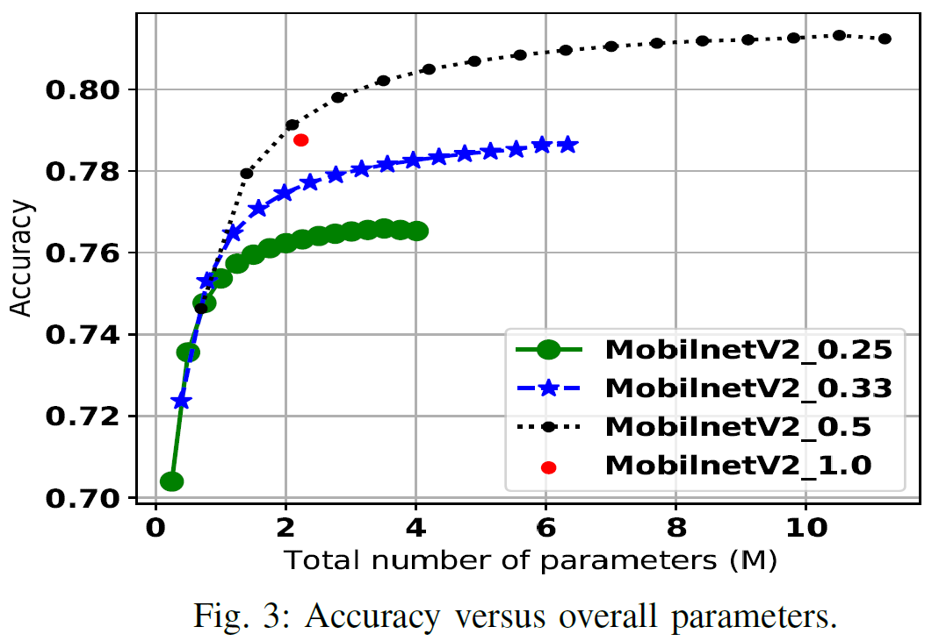
Accuracy vs. parameters
width factor 0.5
→ 30% parameters
→ 2 M parameters
width factor 0.25
→ 6% parameters
6

